Slide 1
Group members
Hammad Shakeel 20K-0368
Moaaz Bin Sajjad 20K-0154
Umer Sheikh 20K-0225

Slide 2
Inception-v2
Introduction
Architecture Block Diagram
Publication Details
Advantages
Disadvantages
Key Components Description
Conclusion

Slide 3
Introduction
The Inception V2 Architecture is an improved version of Inception-V1 Architecture (GoogleNet) .
Inception-v2, also known as Inception-ResNet-v1
It represents a significant evolution from its predecessor, Inception-v1, aiming to address limitations and improve performance in image classification tasks.

Slide 4
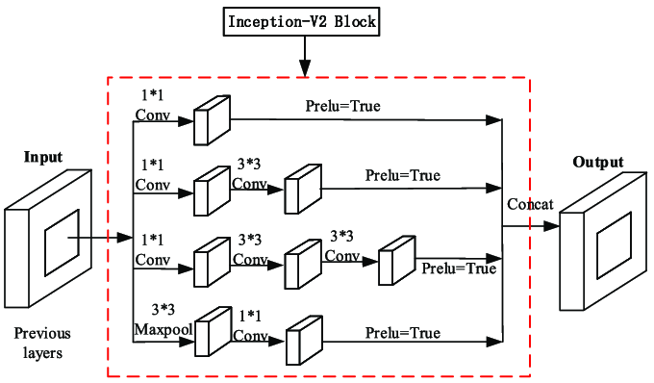
Architecture Block Diagram

Slide 5
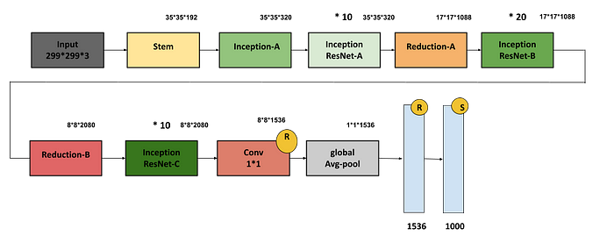
Main Architecture

Slide 6
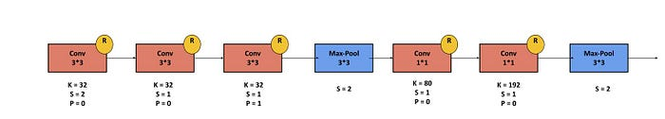
Stem Block

Slide 7
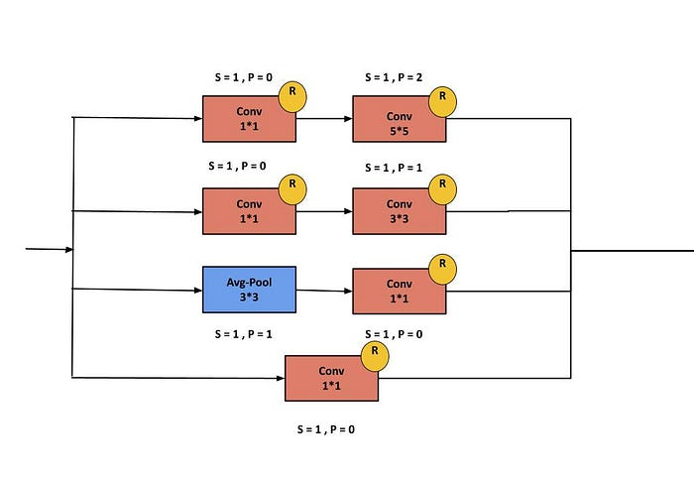
Inception-A Block

Slide 8
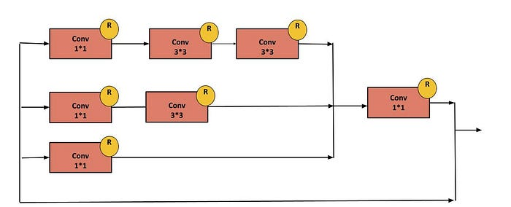
Inception ResNet-A Block

Slide 9
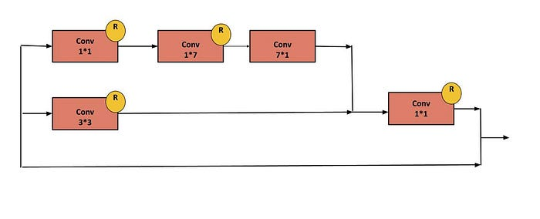
Inception ResNet-B Block

Slide 10
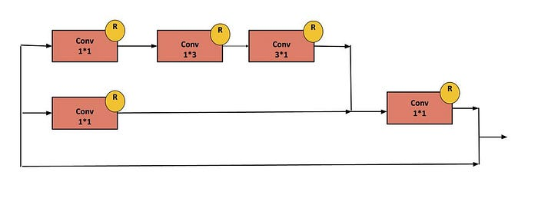
Inception ResNet-C Block

Slide 11
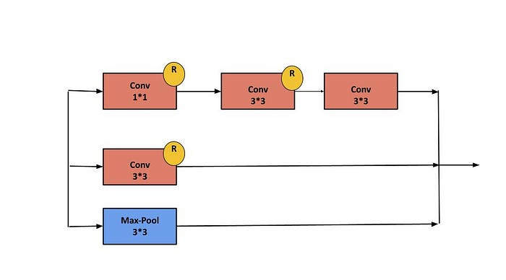
Reduction-A Block

Slide 12
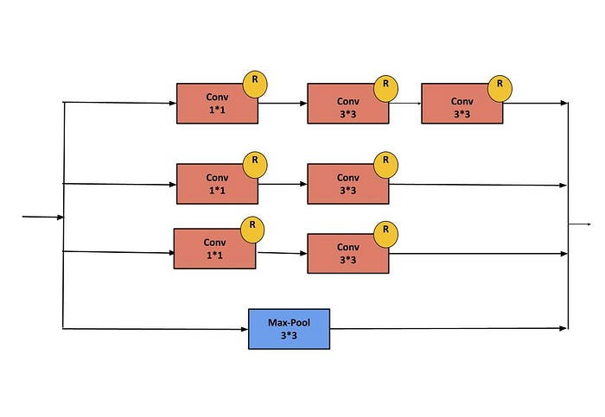
Reduction-B Block

Slide 13
Publication Details
Paper : Rethinking the Inception Architecture for Computer Vision .
Authors : Christian Szegedy, Sergey Ioffe, Vincent Vanhoucke, Alex Alemi , Google Inc .
Authors : Christian Szegedy, Sergey Ioffe, Vincent Vanhoucke, Alex Alemi , Google Inc .

Slide 14
Advantages
Improved Performance
Reduced Computational Cost
Increased Robustness
Scalability
Interpretability

Slide 15
Disadvantages
Complexity
Sensitivity to Hyperparameters
Overfitting
Interpretability Challenges
Implementation Difficulty

Slide 16
Key Components
Factorized Convolutions
Batch Normalization
Residual Connections
Auxiliary Classifiers

Slide 17
Conclusion
Inception-v2 introduces novel concepts like factorized convolutions and Inception modules, enhancing deep learning performance.
Inception-v2 marks a significant advancement in computer vision and deep learning, pushing boundaries in image recognition.
Continued exploration of architectures like Inception-v2 is crucial for driving innovation and tackling complex challenges in research and applications.

Slide 18
Thank YOU
.

